Slide 1
Profit via assortment
Capstone project
The Look Ecommerce

Slide 2
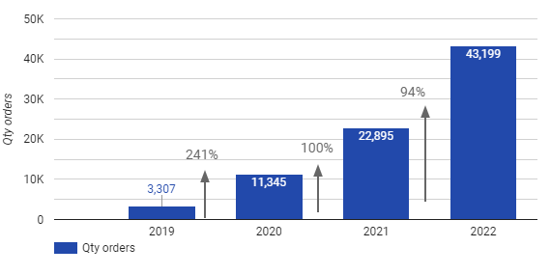
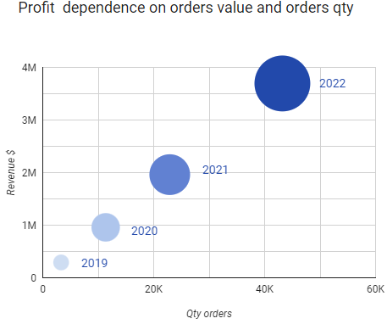
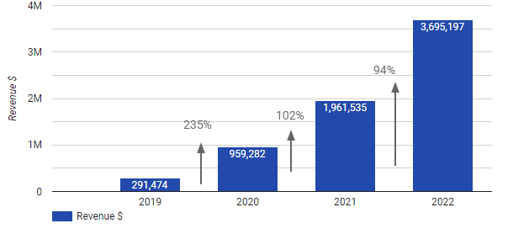
Financial situation overview
Qty orders by year
Profit dependance on order value and order qty
1.9M
Revenue $ by year
1.0M
505K
146K

Slide 3
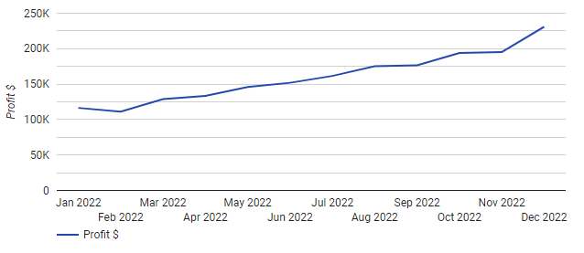
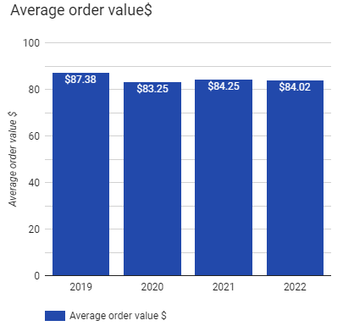
2022 year profit by month
Average order value $ by year
There is no seasonality in this ecommerce business model.
Total average order value 84,73$

Slide 4
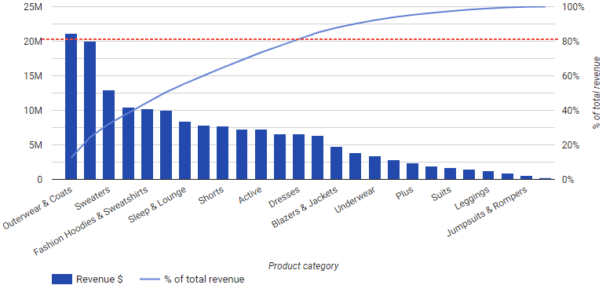
We cannot apply the Pareto principle to this business model. The first 13 product categories (out of 26) comprise roughly 80% of total revenue.
Product categories
Revenue by product categories

Slide 5
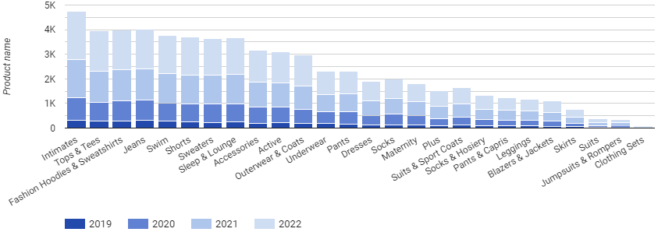
2015
321
32
8
Total product brands
2730
Intimates category
Clothing Sets category
Total product categories
26
Total product names
26801
Product categories by year

Slide 6
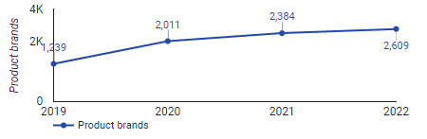
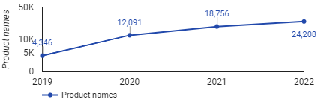
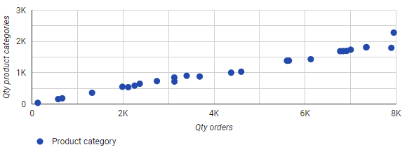
Qty product brands by year
Qty product names by year
Correlation between qty orders and qty product names
The wider the selection of products in a category, the higher the quantity of purchased items.
Therefore, it is beneficial to have a wider assortment in each category.

Slide 7
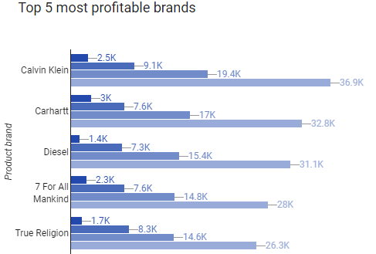
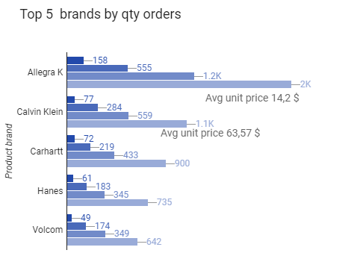


The Calvin Klein brand takes the first place in terms of profitability. Meanwhile, in terms of order quantity, Calvin Klein products sold 49% less than the Allegra K brand.

Slide 8
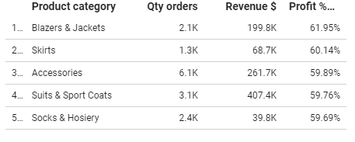
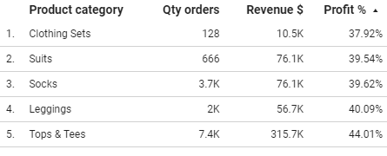
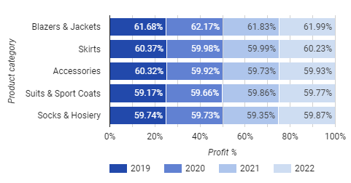
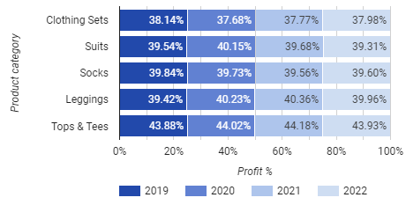
Top 5 most profitable product categories
Top 5 least profitable product categories

Slide 9
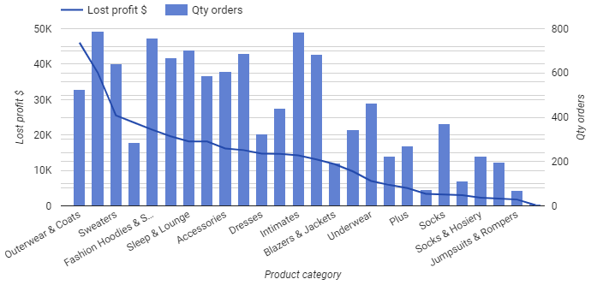
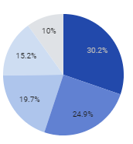

Returned orders
Product categories of returned order
2019 year – 9.9%
2020 year – 9.7%
2021 year – 9.9%
2022 year – 10%
Jeans
Total order by status

Slide 10
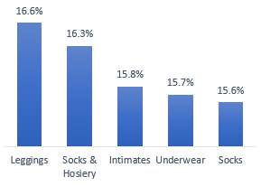
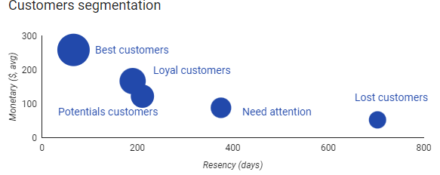
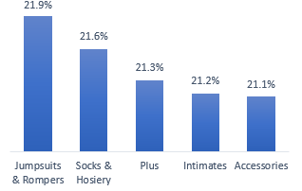
Customers segmentation
Need attention customers in product categories
Lost customers 23.82%
Need attention 25,28%
Loyal customers 19.36%
Potential customers 18.32%
Best customers 13.22%
Lost customers in product categories

Slide 11
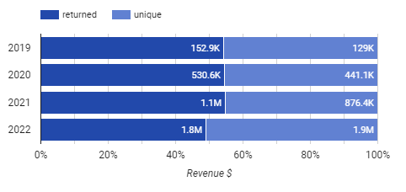
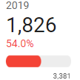
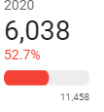
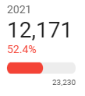
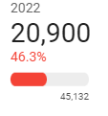
The ratio between returned customers and unique customers has slightly decreased from 54.0% in 2019 to 46.3% in 2022.
Returning customers
Returning customers sales
Orders of returning customers
returning customers
unique customers

Slide 12
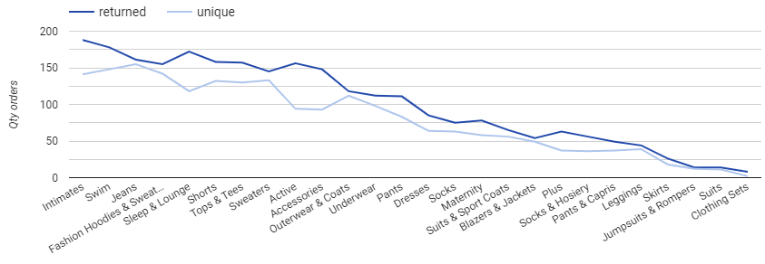
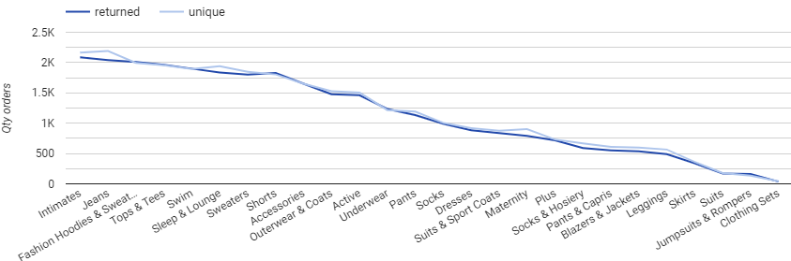
Returning and unique customers orders by product categories 2019 and 2022

Slide 13
Recommendations
To discontinue the “Clothing Sets” and “Jumpsuits and Rompers” product categories.
Expand other categories that have low demand by adding new popular products within those categories.
Check the reason (technical issues, customers satisfaction, unmet customer expectations) of decrease of returning customers. Implement additional marketing measures to increase customer retention.
Take measures to reduce product returns: analyze the reasons for return, check the product descriptions and technical specifications on the online store. Find out if declared product quality matches actual product quality.
Implement additional marketing initiatives to stimulate customer activity in product categories that have the highest percentage of „Lost“ and „Need attanetion“ customers.
2019-2022

